Slide 1
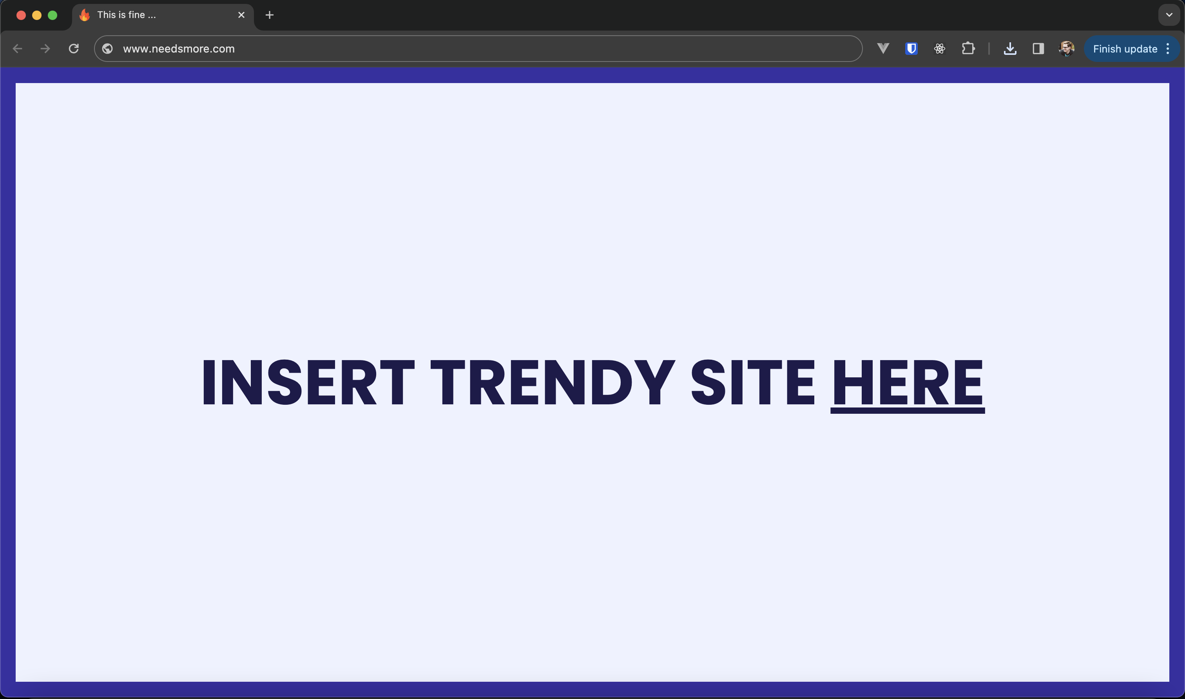
Modern Web Design – Aspects, Trends & The Golden Rule
Front-End Design & Development

Slide 2
The Web Observed in Seconds …
As of 2024 – the landscape for website engagement is more demanding than ever, for example according to Forbes:
47% of users will NOT wait longer than 2 seconds for a website to load
Users spend an average of 5.59 seconds looking at written content on a site
Navigation menus are observed on average for 6.44 seconds by users
Average time spent on a single page is 54 seconds
61% of users state that if they cannot find what they are looking for after 5 seconds, they will leave
#funfact – for every second that passes – 3 new websites are created & added into the existing pool of over 1 billion existing sites!

Slide 3

The Killer
88% of online users will NOT return to a website after a bad experience

Slide 4
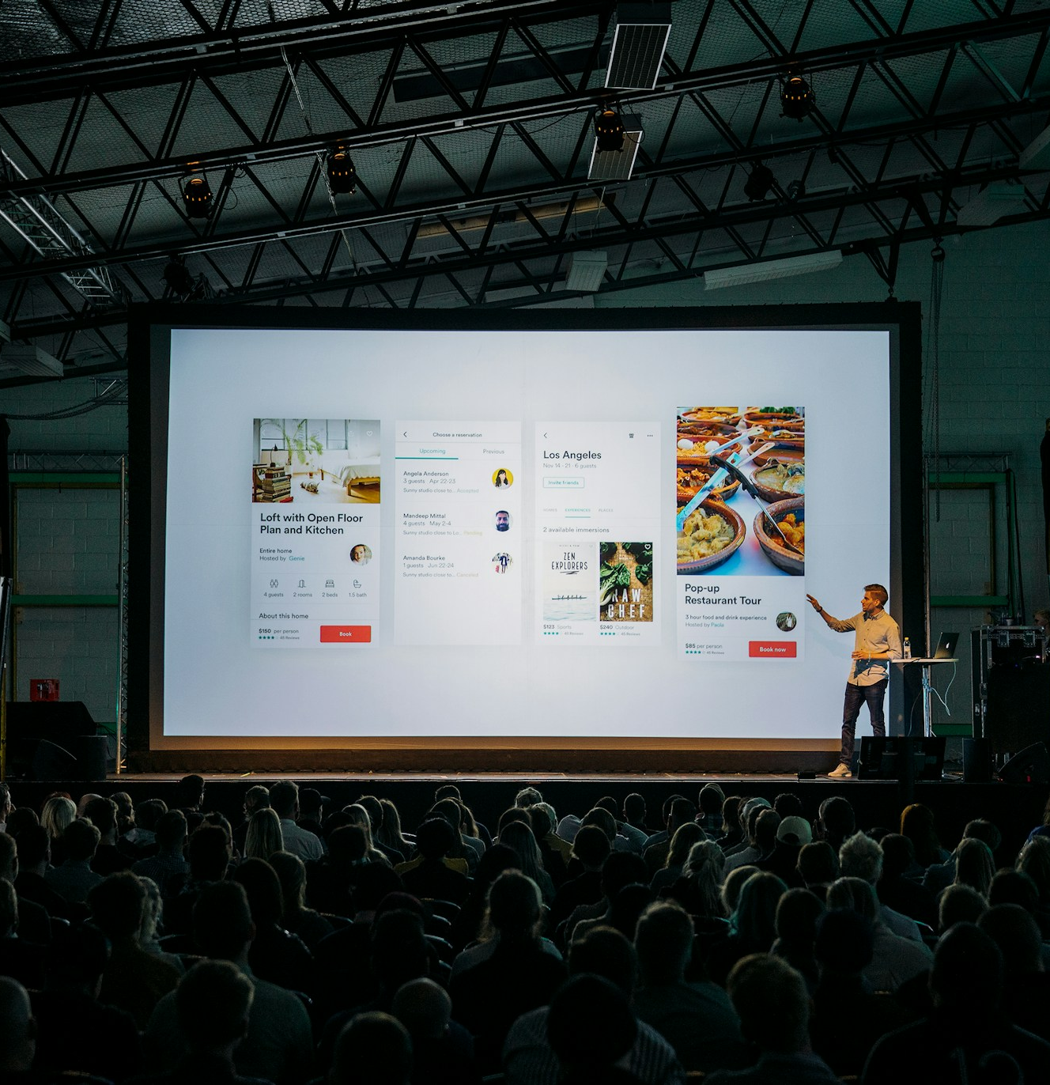
Design Subjectivity
How can we judge & compare one site from another, when much of it is based on our subjective tastes & preferences?
“Bad web design” ≠ what is a bad colour
“Good web design” ≠ what makes good content
Web design is built on how we present the information to the user & if our presentation is effective to our target audience
Most of us make judgment calls on websites ourselves, sometimes even subconsciously because of their design choices that conflict with what we want from the site!

Slide 5

The Golden Rule
The user experience (“UX”) must always be prioritised when designing our website

Slide 6
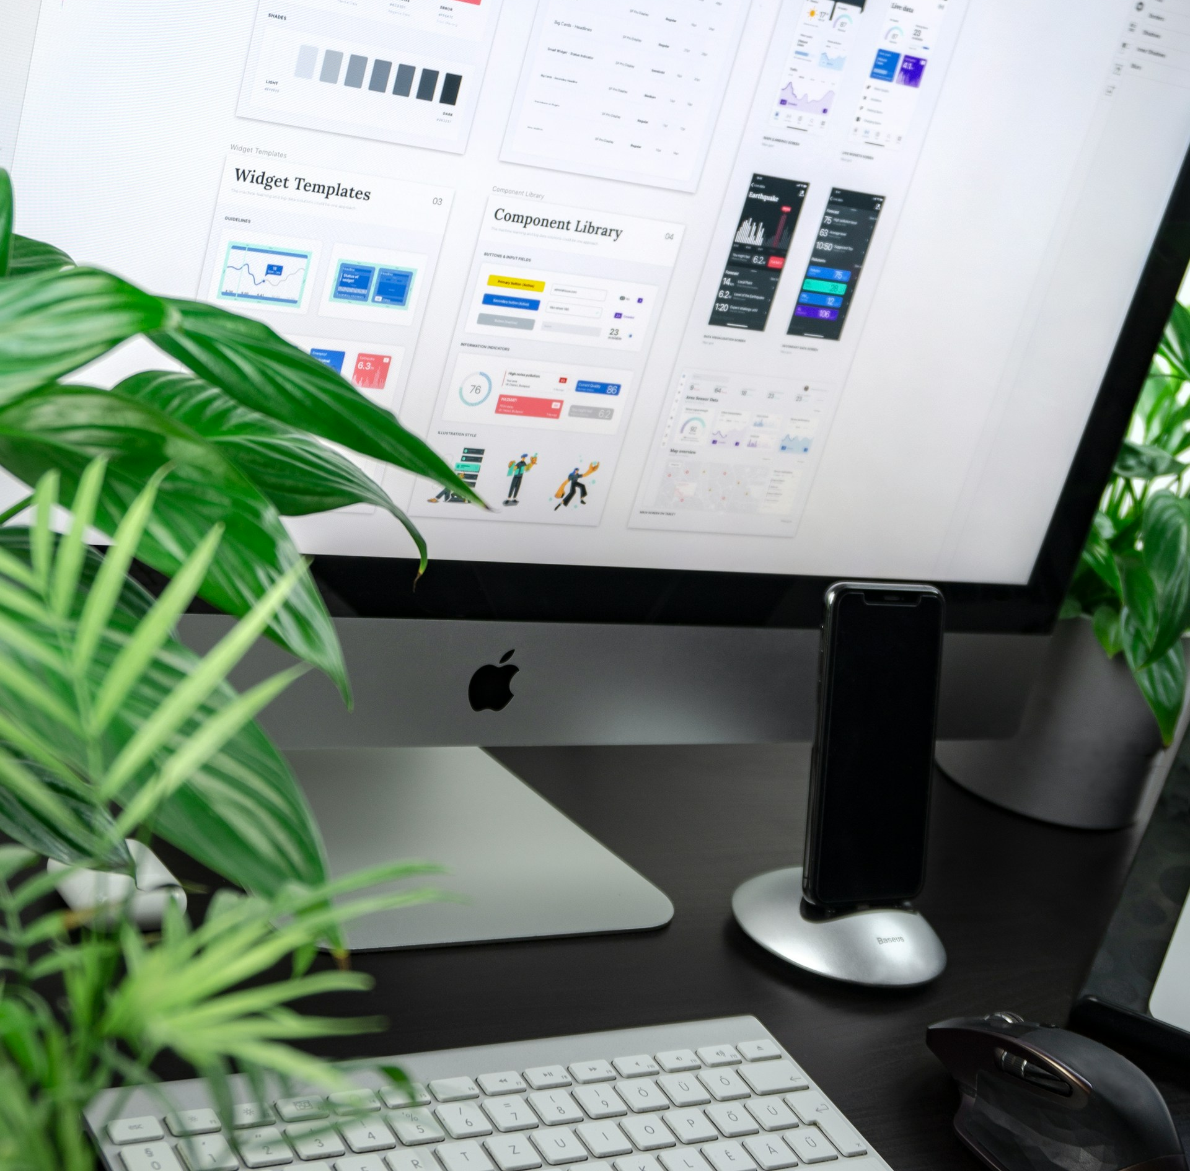
What makes up “UX”
Over many years of analysing user preferences, these following areas improve useability when done right!
Functional Layout
Visual hierarchy
Navigability
Conventionality
Wide Useability

Slide 7
1. Functional Layout
A websites elements & layouts must only be included to serve a functional purpose to the user
Simplicity: Unnecessary design elements should be discarded & maintain tight selection of colours, fonts & graphics.
Minimalist: Reduce aspects which unnecessarily lengthen the user wait time like animations, load times or auto—played media
Consistency: UI & elements used across pages should feel similar and share combined CSS box models like background, colour schemes, borders/box shadows & even wording
The Sin Bin
Dom Perignon (Design > Function, Odd Scroll functionality & Too Many Unnecessary Elements)
Yale School of Art (No clear theme, very loud & contrast issues everywhere)
Netflix (Auto-play of movies on hover leads to “sticky” navigation and trickier decision-making)

Slide 8

Student Focus Test

Slide 9
You will read this first
And you will read this last
And then you will read this
Then this one

Slide 10
2. Visual Hierarchy
Websites need to arrange & style their elements in a cohesive manner to implicitly indicate priorities on a page to a user
Important elements, critical to the sites purpose (like sales banners OR price plans) must be arranged to make users naturally gravitate to them
Aspects such as page position, sizing/colour, background of the section/box are all used to split sections from the crowd
Scannability is of content critical – tests indicate 79% of users always scanned a new page, whereas only 16% read word-for-word
The Sin Bin
NYU (Use of Colour & Same UI Everywhere)
Wayfair (Use of Colour & Too Many Same Priorities)
AliExpress (popup galore & extreme information density)

Slide 11
3. Navigability
Websites require intuitive & clear navigation on all pages to ensure visitors can find what they’re looking for
Primary navigation should be simple & at the top, separated from main content & visible!
Consider alternative navigation like breadcrumbs and search bars, where sitemaps are heavily nested
Sidebar navigation is generally associated with either mobile navs or shopping carts
Footer navigation should generally be included and can show complex content options where the main navbar cannot
The Sin Bin
ZARA (Very Poor Navigation UI)
GoodReads (No Top Nav & Difficulty Finding Navigation Areas)

Slide 12
4. Conventionality
Good websites typically play into the expectations & prior web experiences of users
Novelty is important but not at the expense of good, conventional UX
Breaking from convention can confuse or frustrate users
You need a good reason to break from what users understand & feel comfortable with!
The Sin Bin
Wix Studio (In-Page Navigation is “Questionable” & Dreaded Horizontal Scroll)
SCTI (Buttons that do not work as CTAs)
UI (on-purpose example of how FRUSTRATING UI can be if designed AGAINST convention)
PasswordGame (even functional & conventional UI can be taken too far)

Slide 13
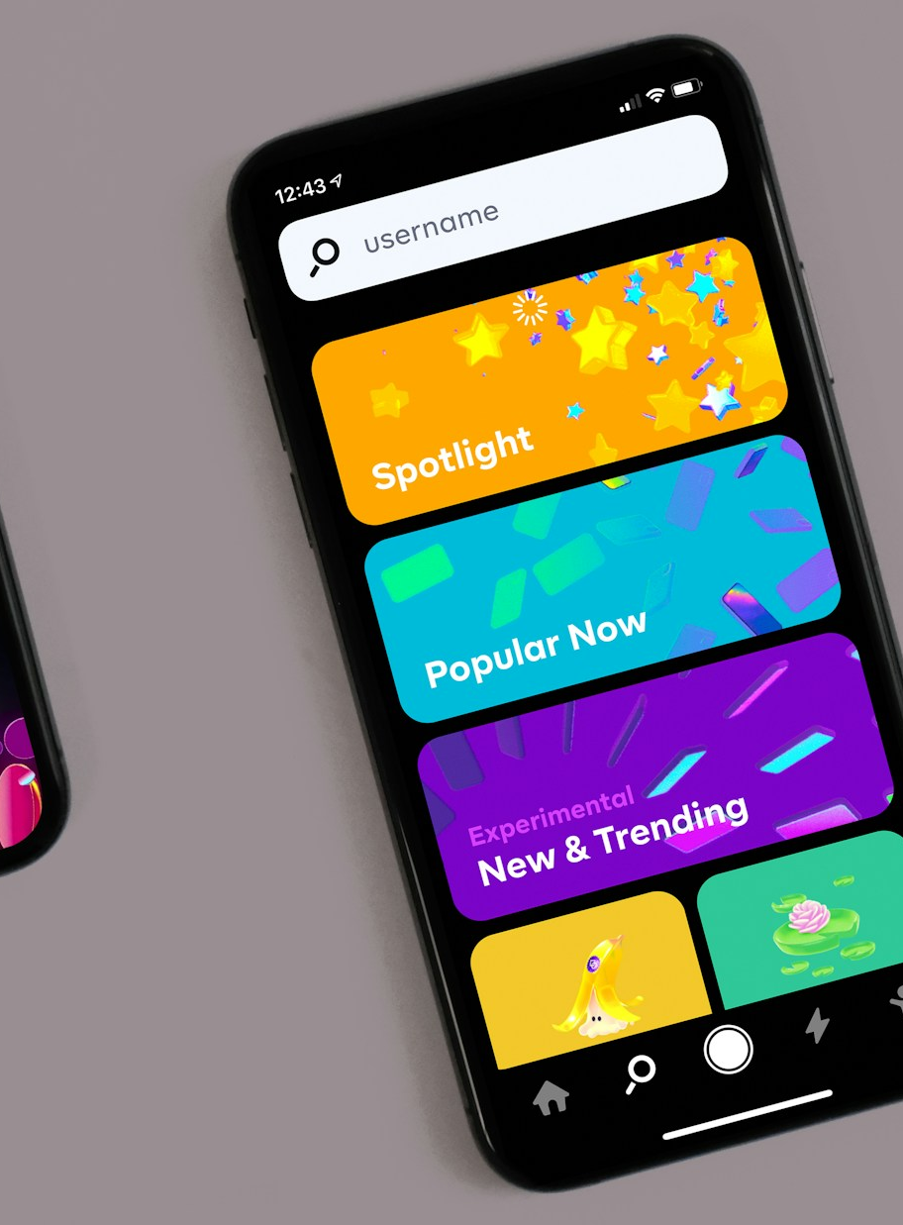
Common Conventions
Main navigation bar at top of the screen, separated from content & visible
Logo displayed in top-left of page & clickable as anchor
Videos/media only plays when clicked
Hover effects on buttons/links
Shopping cart icon to indicate ecommerce functionality
Image sliders contain buttons to navigate slider manually
Minimise popups & “aggressive” UI that interferes with user’s experience
… where each convention allows for clear & easy function – diverging from this may only serve to counteract the functionality!

Slide 14
5. Wide Useability
Websites need to target users with a wide array of access requirements & avoid denying access
Accessibility: Website modifies elements/UI that would otherwise negatively impact those with disability or access issues
Responsiveness: Addition of CSS & UI that targets users on different device sizes & prevents a website breaking on smaller screens
* We have covered this already & many sites commonly suffer from these issues & are probably the easiest to spot when they occur!

Slide 15

The Depths
DailyMailUK Sports – Loud visual hierarchy, insane information densite & terrible convention of masses of ad popus & auto-playing ads circa 1995
Alibaba – Extremely frustrating/intrusive navbar, odd auto-generated wording & shop section showing very bland UI with over-compressed information density
Reddit ReDesign - Reduced information density which is actually BAD for news aggregator, meaning current users use old site domain instead
But also note – how far we have come …

Slide 16
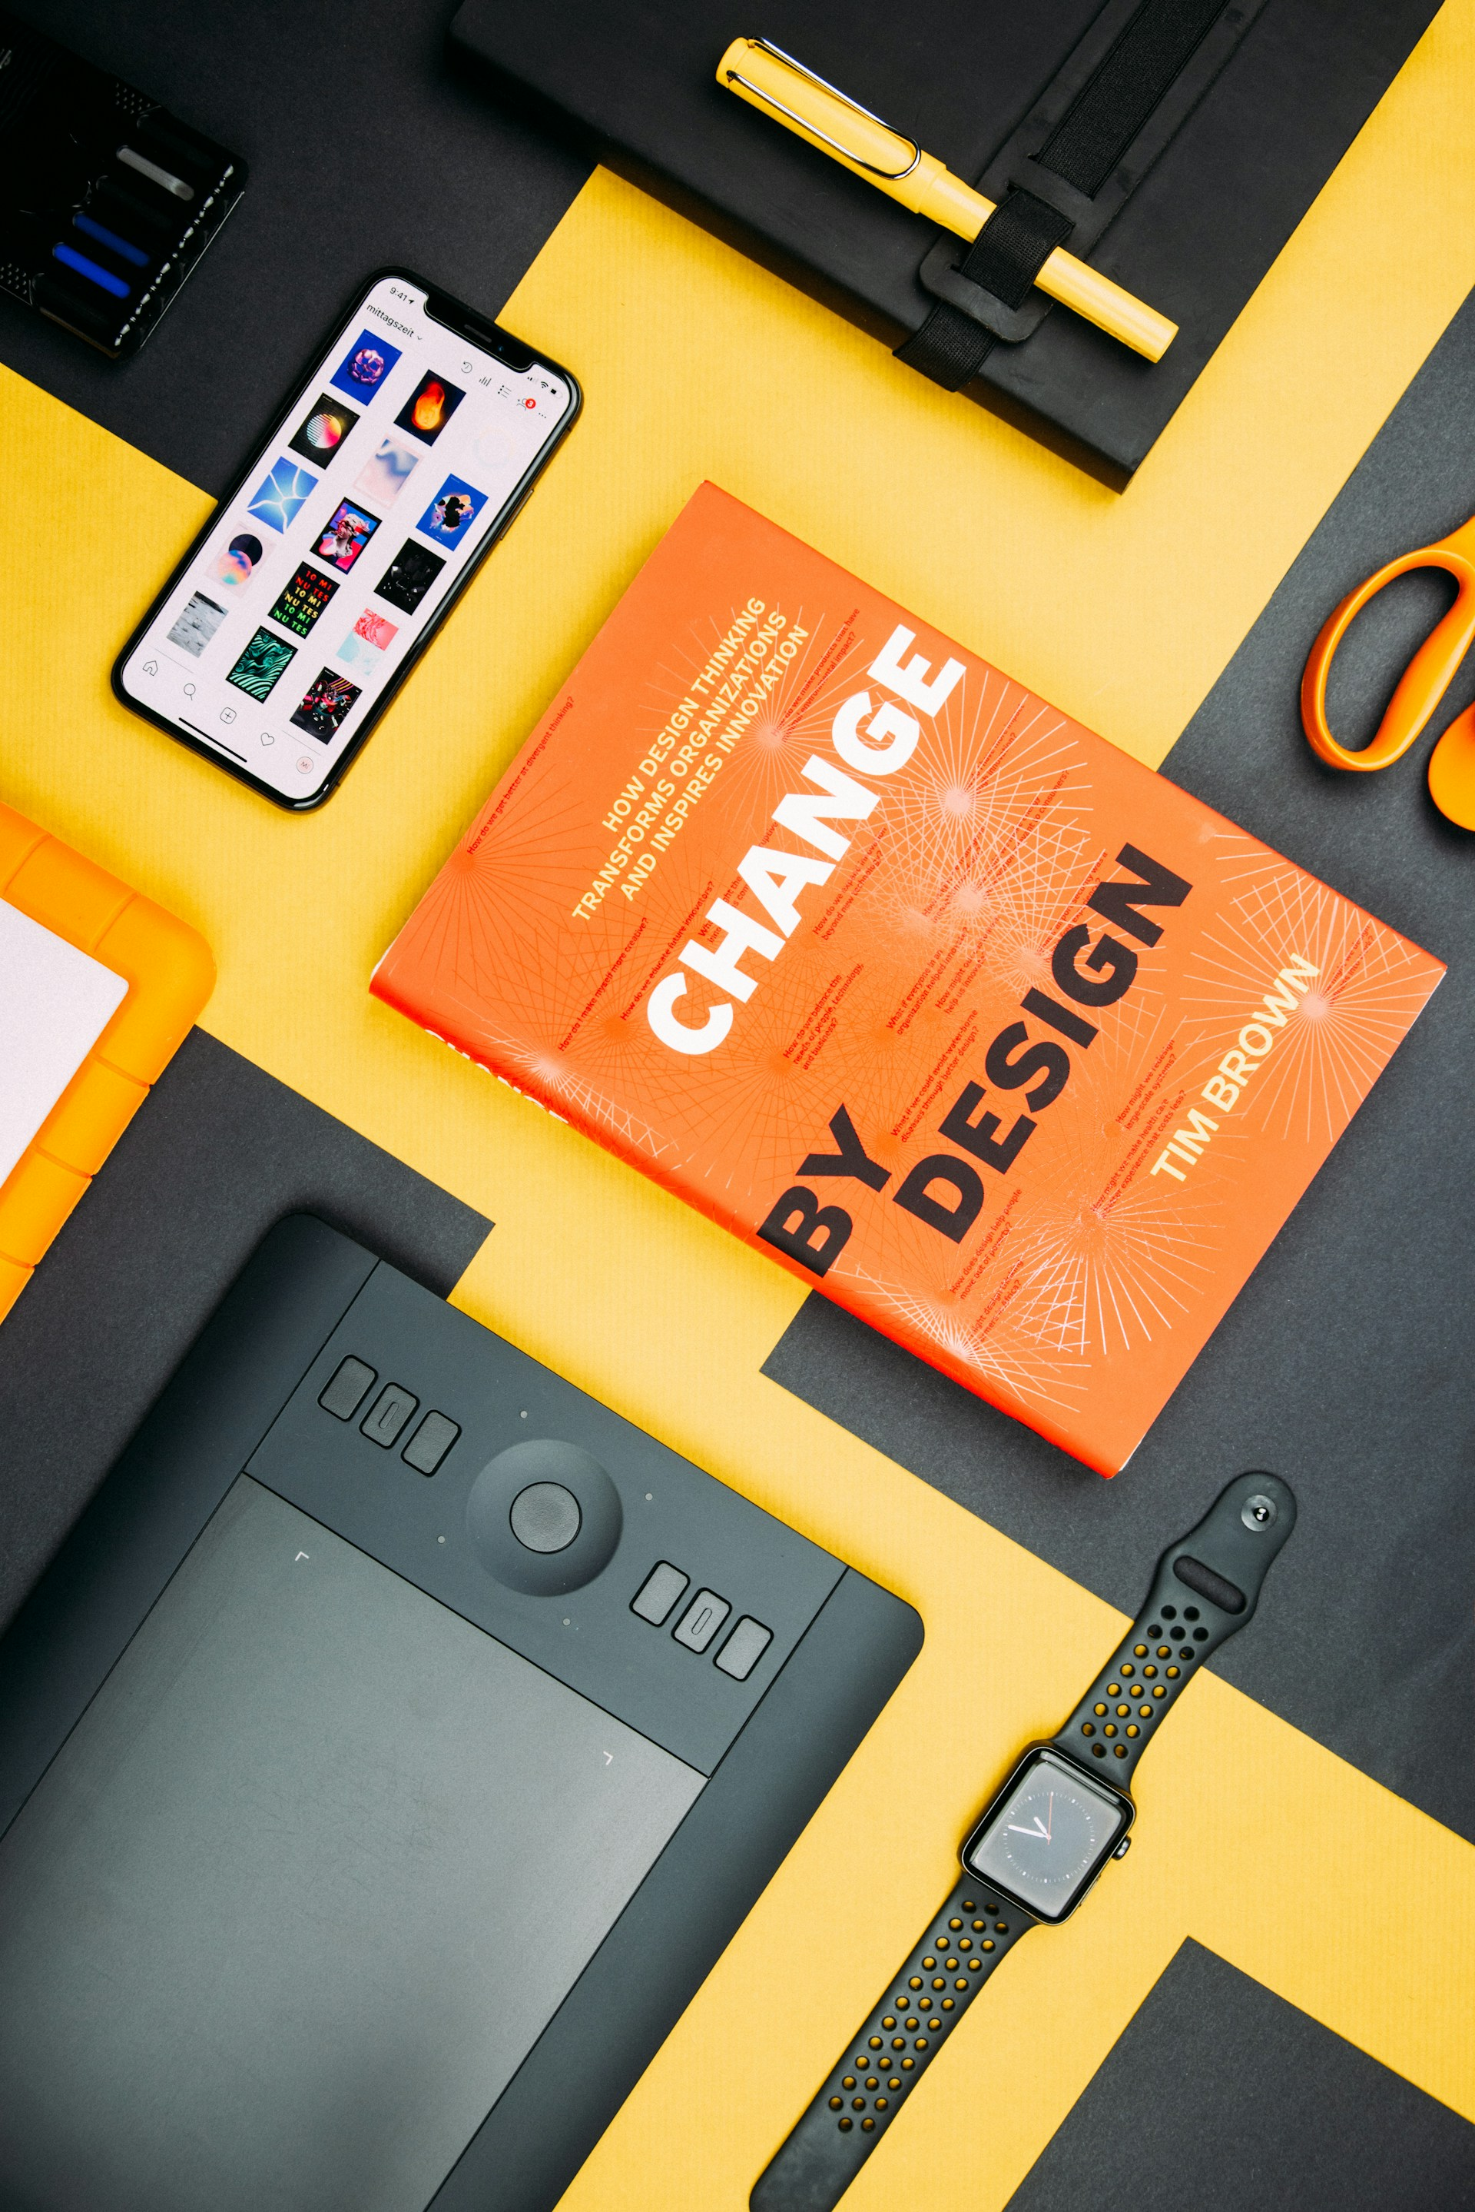
Final Word on Trends & practices
Fonts should match content BUT ALAWAYS encourage scannability
Colour schemes should have more than three main colour “tokens” WITHOUT good reason
Padding & whitespace should be used to let content breathe & separate content sections
Images should be used to engage, complement & break-up text
Navbars should be simple BUT bow to convention
Do not present users more than a few core options
Only use buttons for Calls to Action (use carefully - visual hierarchy)
… and per the Golden Rule – ALWAYS put user experience FIRST!

